Slide 1

IT18X97 PARALLEL PROGRAMMING | DELIVERABLE 2
HeatGrid
Resource-aware MPI heat diffusion using domain decomposition
How splitting the grid (1D slab vs 2D Cartesian) and exchanging halos (blocking vs non-blocking) affect runtime on a 2-core laptop, applied to Johannesburg-style urban heat scenarios.
Clarence Ebebe
Student number 222086329
Notes:
Introduce the project: HeatGrid studies how grid decomposition and halo exchange mode affect runtime of a 2D heat diffusion solver on a 2-core laptop. Module IT18X97 Parallel Programming, Deliverable 2.

Slide 2
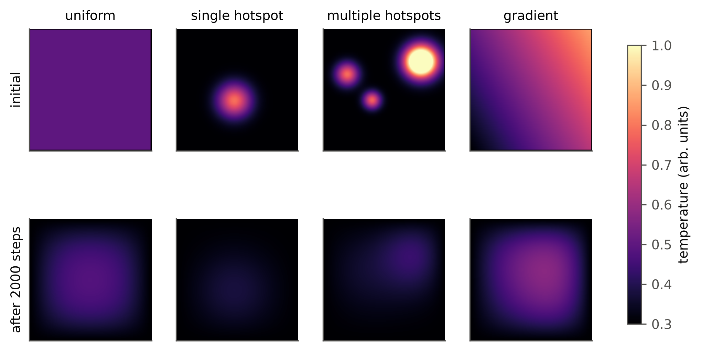
Problem, context and motivation
1
The problem
Every cell updates from its four neighbours each step. Splitting the grid forces halo swaps every step, and that cost is what this study measures.
2
Why parallel fits
Each step is data-parallel with local, regular communication, a clean test of decomposition and communication choices.
3
South African relevance
Scenarios mirror Johannesburg heat structure: a heat island, hotspots and a gradient. Runs on commodity hardware, no cluster.
Seeded synthetic input scenarios, initial and after 2000 steps. Not measured temperatures.
SDG 9, target 9.5: strengthening research capability on low-cost hardware. This project makes no climate prediction; any SDG benefit is a possible future use.
Notes:
Heat diffusion is a standard stencil computation. Parallelising it needs halo exchange every step, which is the cost studied. The Johannesburg scenarios are framing only, not measured data. Check the SDG target against the D1 proposal.

Slide 3
Research gap, questions and contribution
Research gap
RQ1
At 1 to 4 processes on one node, for which grid sizes does a 2D Cartesian decomposition beat a 1D slab decomposition?
Decomposition and overlap studies usually target clusters with many cores and fast networks. Little is reported for 1 to 4 processes on one small shared-memory machine, the hardware many African students and small groups actually have.
Contribution
RQ2
How much does non-blocking halo exchange with interior overlap save over blocking exchange, and does the saving fit the measured communication time?
Five implementations sharing one stencil kernel
Reproducible, seeded benchmark pipeline
Measured answer to RQ2, argued limit for RQ1
Notes:
Gap: most decomposition studies assume clusters. This work looks at 1 to 4 processes on one small machine. Check the gap wording against the D1 literature review.

Slide 4
Sequential and parallel design
rank 0
rank 0
rank 1
Non-blocking step
rank 1
1
Post Irecv and Isend for each halo
rank 2
rank 2
rank 3
2
Update interior cells while data moves
rank 3
3
Waitall for the halo transfers
1D slab
N/S halo rows
2D Cartesian (2x2)
N/S rows, W/E columns
4
Update edge strips, swap buffers
u' = u + r(N+S+E+W-4u), r = 0.2
Blocking: Sendrecv per neighbour (2 slab, 4 Cartesian). Columns use an MPI vector datatype. No corner exchange needed.
Timing: Barrier, then MPI.Wtime around the step loop only, max over ranks.
Five-point FTCS stencil shared by all five variants. The sequential baseline imports no MPI, so MPI overhead stays visible.
Notes:
All variants share one stencil kernel, so they differ only in decomposition and communication. Uneven sizes give the first n mod p blocks one extra row or column. Global edges use MPI.PROC_NULL neighbours. Non-blocking overlaps the interior update with the halo transfer.

Slide 5
Experimental setup
Hardware
Software
Inputs
Intel Core i5-7360U, 2 physical / 4 logical cores, 8 GB RAM, macOS 13. All communication is intra-node.
Python 3.11, NumPy 2.4.6, mpi4py 4.1.2, MPICH 4.3.2, matplotlib 3.11.
Seeded synthetic fields: uniform, single hotspot, multiple hotspots, gradient, plus decaying sine for validation.
Sweeps
Protocol
Correctness
Scaling: 500², 1000², 2000² at 1, 2, 4 processes, 4 variants plus sequential. Scenarios: 1000², 2 processes.
200 steps, 1 warm-up and 5 trials, median and IQR. 54 configurations, 324 runs, 0 failed, shuffled order.
Error vs sequential must be at most 1e-12 before every timed run, plus checksums and 14 automated tests.
4 processes on 2 cores is oversubscribed. These runs are flagged and not used as scaling evidence.
Notes:
Timing covers only the step loop; setup, the correctness check and I/O are excluded. Sequential uses perf_counter. Run order shuffled with seed 7919. Full suite took 58 minutes.

Slide 6
Working prototype demonstration
1
2
3
4
Validate
Sequential vs MPI
Compare
Pipeline
Analytic error ratio 4.00 (second order). All MPI variants match sequential with error 0.0.
1000², single hotspot, 100 steps: sequential vs 2-rank slab non-blocking.
Slab blocking vs non-blocking (RQ2), then 4-rank Cartesian 2x2 (RQ1).
Config, raw CSV, then summarise, make figures and show results.
Demo machine: Apple M1 (8 cores), not the i5 used for the results. Demo timings are a functional check, not performance evidence.
Notes:
Follow DEMO.md. Step 1: python scripts/validate.py. Step 2: sequential vs mpiexec -n 2 slab_nonblocking. Step 3: slab_blocking vs slab_nonblocking, then mpiexec -n 4 cartesian_nonblocking. Step 4: README, config/full.json, raw CSV, summarise.py, make_figures.py, show_results.py. Say on camera that this is an M1, not the i5.

Slide 7
Results: correctness and speedup
0.0
max abs error vs sequential, all 54 configurations
1.01x
best 2-rank speedup (2000², non-blocking)
18 / 18
pairs where non-blocking beat blocking
Speedup 0.75, 0.87 and 1.01. The NumPy stencil is memory-bandwidth bound and both cores share that bandwidth, so 2 ranks top out near 1.0x.
Notes:
Best 2-rank variant is Cartesian non-blocking at every size; at 2000 squared slab non-blocking ties at 10.632 s. Throughput: sequential 83, 86, 74 MLUPS; best 2-rank 62, 75, 75 MLUPS. Two processes barely add throughput. Do not claim any speedup above 1.01.

Slide 8
Discussion: answering RQ2 and RQ1
RQ2 Blocking vs non-blocking
RQ1 Slab vs Cartesian
17 to 65%
2x1 = 2x1
faster with overlap, 2 ranks, 12 pairs
at 2 ranks both splits are identical
Faster in all 18 pairs, including 40 to 68% on oversubscribed 4 ranks
Saving divided by blocking comm time: 0.34 to 1.42
Unexpected: at 2000² the saving exceeds the comm time, so blocking costs time outside Sendrecv (likely rank waiting, untested)
Ratios of 0.62 to 1.14 at 2 ranks reflect noise and code paths, not shape
A real 2x2 split needs 4 ranks, which is oversubscribed here
There, Cartesian was slower in 5 of 6 cases: not answerable on this hardware
Notes:
RQ2: non-blocking won every pair. Where the saving exceeds the blocking comm time, blocking also costs time outside the timer, plausibly ranks waiting on each other. RQ1: at 2 ranks Compute_dims gives 2x1, same as slab. Other findings: scenario differences are noise since the stencil does the same work; slab_blocking 1-rank 2000 squared outlier at 62.8 s is reported as measured.

Slide 9
Conclusion, limitations and future work
Answers
Limitations
Future work
RQ1: not answerable on 2 cores
RQ2: overlap cut runtime in every pair
MPI reaches about 1.0x; communication mode matters more than decomposition shape
One 2-core machine, shared memory only
4-rank runs are oversubscribed
NumPy kernel, same for every variant
Synthetic scenarios, no real temperatures
Rerun on 8+ physical cores to test RQ1
Compiled kernel (C, Numba or Cython)
Time synchronisation waits separately
Distributed initial field, then real Johannesburg inputs
Measured: correctness, runtimes, RQ2 savings. Possible future benefit: efficient simulation on cheap hardware could support urban-heat studies. Not shown here.
Notes:
Also note: non-blocking comm time captures only un-hidden waiting; every rank builds the full initial field; the suite metadata records commit c37967a, run from the working copy just before commit 40bf548.

Slide 10
References and acknowledgements
Message Passing Interface Forum. MPI: A Message-Passing Interface Standard, Version 4.0, 2021.
Dalcin, L. and Fang, Y.-L. L. mpi4py: Status Update After 12 Years of Development. Computing in Science & Engineering 23(4), 2021.
Harris, C. R. et al. Array programming with NumPy. Nature 585, 2020.
Hunter, J. D. Matplotlib: A 2D Graphics Environment. Computing in Science & Engineering 9(3), 2007.
Gropp, W., Lusk, E. and Skjellum, A. Using MPI, 3rd ed. MIT Press, 2014.
Hoefler, T. and Belli, R. Scientific Benchmarking of Parallel Computing Systems. SC15, 2015.
LeVeque, R. J. Finite Difference Methods for Ordinary and Partial Differential Equations. SIAM, 2007.
Williams, S., Waterman, A. and Patterson, D. Roofline: An Insightful Visual Performance Model for Multicore Architectures. CACM 52(4), 2009.
MPICH. https://www.mpich.org
Acknowledgements
AI assistance was used as declared in the AI-use statement.
Notes:
Add the Johannesburg urban heat island sources and other references from the D1 proposal and D2 paper.

